Slide 1
Shoe Size Converter
Courtney Abrams
Christina DiPietro
Sophie Hoeke

Slide 2
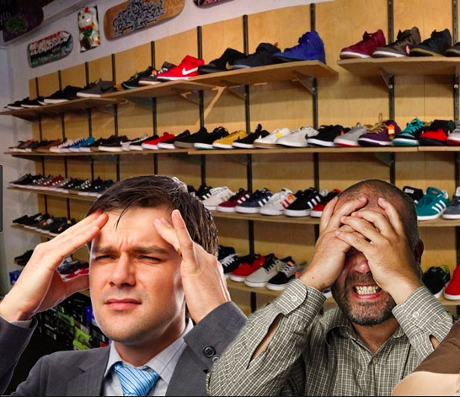
The Problem
No easy way to convert shoe sizes when shopping in stores
Different brands from different countries are desired by consumers
Difficult to gather size information in a timely and efficient manner

Slide 3
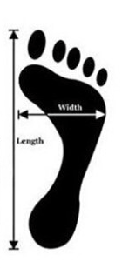
The Solution
Allows shoppers to easily pull up size conversion information for different countries
Gives both men and women the ability to gather information regarding their shoe size
Makes life easier for the in-store shoe shopper

Slide 4
Python Code “To Do” List
Import lxml, pandas, & warnings
Read shoe size HTML chart
Find gender sizes in HTML chart
Create dictionaries for genders and countries
If / Elif statements
Function and Call
Print Data

Slide 5
Python Program Flowchart (Input Statements)
“Are you
a male or
female?”
“What is your
country of
residence?”
“What
size shoe
are you?

Slide 6
Python Program Flowchart (Output Statement)
Calculating result
Prints your shoe size in USA, UK, or European countries
HTML Chart

Slide 7
Questions?

Slide 8
Work Allocation
Courtney
Her role on the project consisted of creating the input statements, as well as if / elif statements for genders.
Christina
She created the dictionaries, helped construct the poster, and helped problem solve throughout the project duration.
Sophia
Due to prior knowledge and experience with coding languages, Sophia was the team leader. She created the function for countries, as well as imported the charts.
**All team members were present at each meeting and constructed the code together

